Slide 1
Two seahorses
Raha Shabani- 1993609

Slide 2
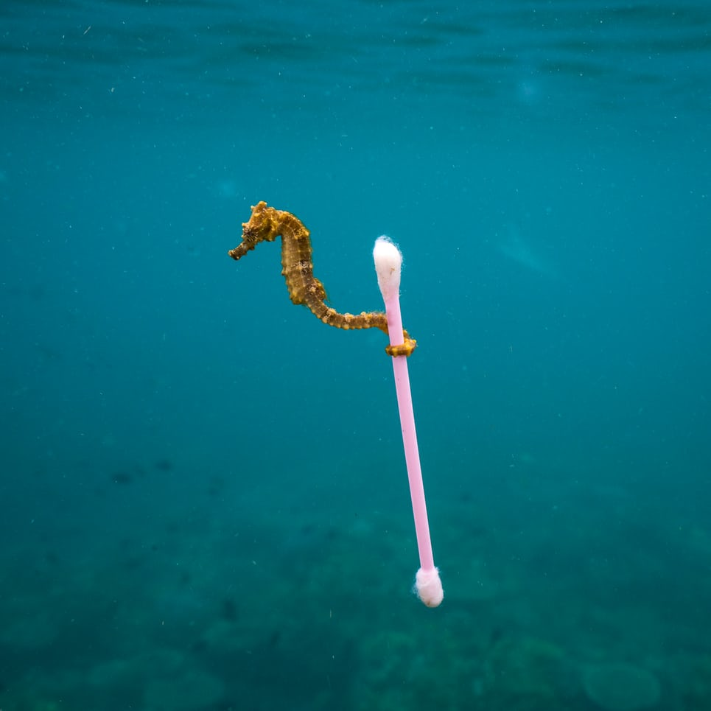
Two seahorses robot carry a stick together stack to their wrapped tails

Slide 3
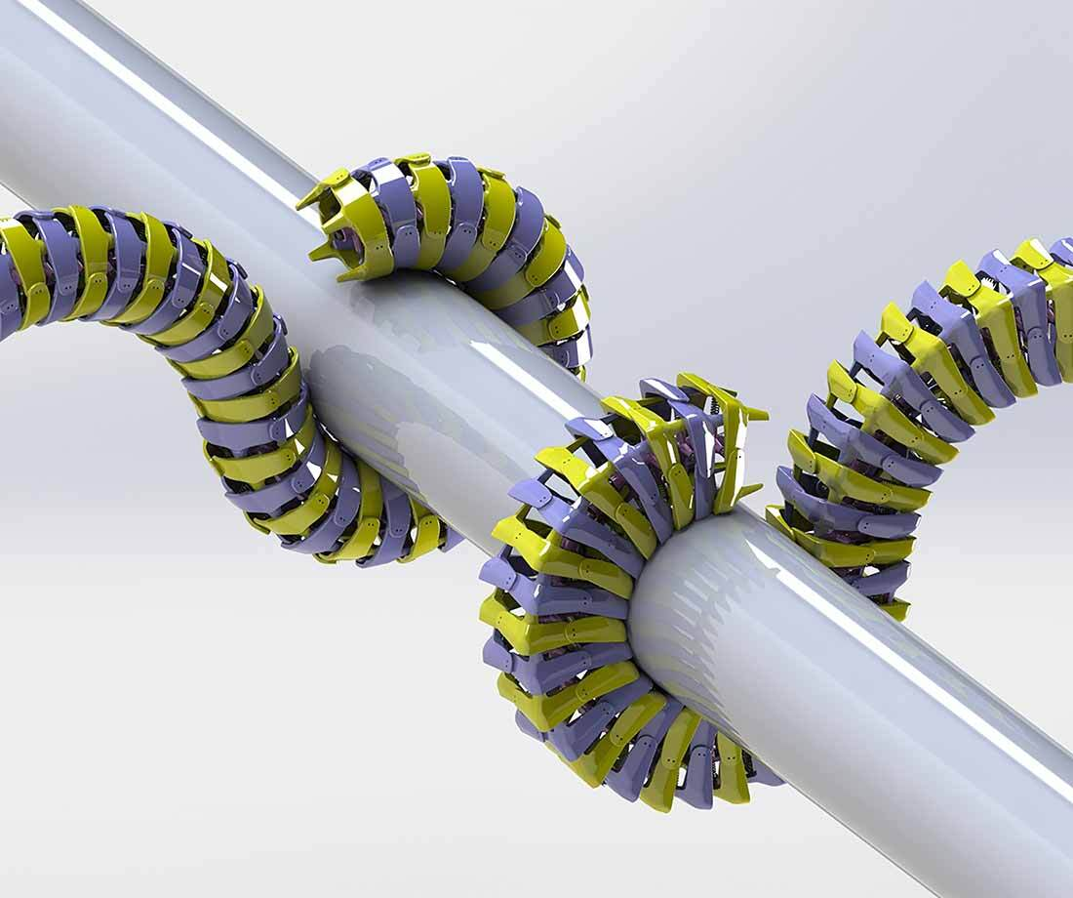
Purpose:

Slide 4
Seahorses particular interest:
Scientists believe in the design of bots
Strong
flexible enough to perform tasks in real-world settings.

Slide 5
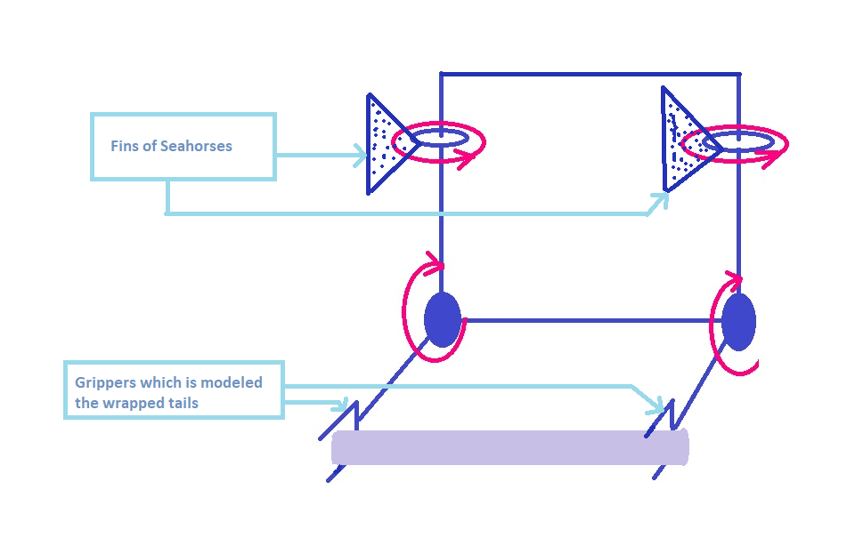
Seahorses' kinematics

Slide 6
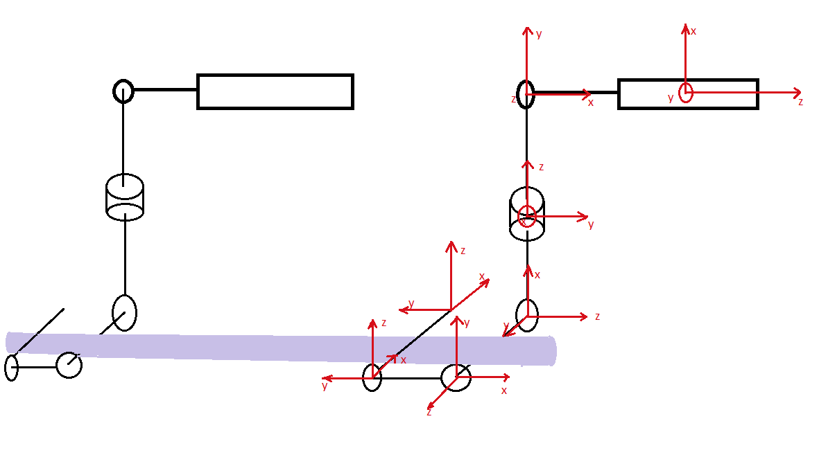
Seahorses' kinematics

Slide 7
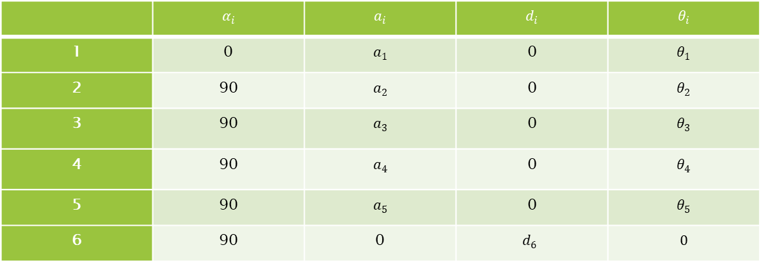

DH parameters
$q={\left(X,Θ\right)}^{T}where X={\left(x,y,z\right)}^{T}, Θ={\left(ψ,θ,ϕ\right)}^{T}$
 | $$α_{i}$$ | $$a_{i}$$ | $$d_{i}$$ | $$θ_{i}$$
1 | 0 | $$a_{1}$$ | 0 | $$θ_{1}$$
2 | 90 | $$a_{2}$$ | 0 | $$θ_{2}$$
3 | 90 | $$a_{3}$$ | 0 | $$θ_{3}$$
4 | 90 | $$a_{4}$$ | 0 | $$θ_{4}$$
5 | 90 | $$a_{5}$$ | 0 | $$θ_{5}$$
6 | 90 | 0 | $$d_{6}$$ | $$0$$

Slide 8
Output of DH parameters m-file
'R is Rotation Matrix'
[[sin(t5) #1 - cos(t5) #4, sin(90) #6 + cos(90) sin(t5) #4 + cos(90) cos(t5) #1,
cos(90) #6 - sin(90) sin(t5) #4 - sin(90) cos(t5) #1],
[cos(t5) #3 - sin(t5) #2, sin(90) #5 - cos(90) sin(t5) #3 - cos(90) cos(t5) #2,
cos(90) #5 + sin(90) sin(t5) #3 + sin(90) cos(t5) #2],
[cos(t5) #8 - sin(t5) #7, - sin(90) #9 - cos(90) sin(t5) #8 - cos(90) cos(t5) #7,
sin(90) sin(t5) #8 - cos(90) #9 + sin(90) cos(t5) #7]]

Slide 9
Output of DH parameters m-file
'd is translation Matrix'
[[a1 cos(t1) - d6 (sin(90) sin(t5) #6 - cos(90) (cos(90) #7 - sin(90) sin(t4) #14 + sin(90) cos(t4) #13) + sin(90) cos(t5) #1)
- a3 sin(t3) #19 + a3 cos(t3) #20 - a5 cos(t5) #6 + a2 cos(t1) cos(t2) - a4 cos(t4) #14 - a2 sin(t1) sin(t2) - a4
sin(t4) #13 + a5 sin(t5) #1],
[a1 sin(t1) + d6 (cos(90) (sin(90) sin(t4) #12 - cos(90) #8 + sin(90) cos(t4) #11) + sin(90) sin(t5) #5 + sin(90) cos(t5) #2)
+ a3 sin(t3) #16 + a3 cos(t3) #17 + a5 cos(t5) #5 + a4 cos(t4) #12 + a2 cos(t1) sin(t2) + a2 cos(t2) sin(t1) - a4
sin(t4) #11 - a5 sin(t5) #2],
2
[d6 (sin(90) sin(t5) #4 - cos(90) (cos(90) #9 - sin(90) sin(t3) sin(t4) + sin(90) cos(t4) #10) + sin(90) cos(t5) #3)
+ a3 sin(90) sin(t3) + a4 sin(t4) #10 + a5 cos(t5) #4 - a5 sin(t5) #3 + a4 sin(90) cos(t4) sin(t3)]]

Slide 10

Z Y X Euler rotation matrix is:
$$R_{z′y′x′}=\left[\begin{matrix}c_{θ} c_{ψ} & c_{ψ}s_{θ} s_{φ} −c_{φ}s_{ψ} & s_{φ}s_{ψ} + c_{φ}c_{ψ}s_{θ} \\ c_{θ} s_{ψ} & c_{φ}c_{ψ} + s_{θ}s_{φ}s_{ψ} & c_{φ}s_{θs_{ψ}}−c_{ψ}s_{φ} \\ −s_{θ} & c_{θ}s_{φ} & c_{ θ}c_{φ}\end{matrix}\right]$$

Slide 11

The homogeneous transformation matrix of body frame
$$\left[\begin{aligned}c_{θ} c_{ψ} \\ c_{θ} s_{ψ} \\ −s_{θ} \\ 0\end{aligned} \begin{aligned}c_{ψ}s_{θ} s_{φ} −c_{φ}s_{ψ} \\ c_{φ}c_{ψ} + s_{θ}s_{φ}s_{ψ} \\ c_{θ}s_{φ} \\ 0\end{aligned} \begin{aligned}s_{φ}s_{ψ} + c_{φ}c_{ψ}s_{θ} \\ c_{φ}s_{θs_{ψ}}−c_{ψ}s_{φ} \\ c_{ θ}c_{φ} \\ 0\end{aligned} \begin{aligned}d1 \\ d2 \\ d3 \\ 1\end{aligned}\right]$$

Slide 12

So by post-multiplying the T with trans _{±xb} and trans _{±yb} , we can obtain the resulting end-effector frames
${Trans}_{±XB}= \left[\begin{aligned}1 \\ 0 \\ 0 \\ 0\end{aligned} \begin{aligned}0 \\ 1 \\ 0 \\ 0\end{aligned} \begin{aligned}0 \\ 0 \\ 1 \\ 0\end{aligned} \begin{aligned}±L_{q} \\ 0 \\ 0 \\ 1\end{aligned}\right]$
$T_{M_{1l}}^{0}={T_{B}^{0}∗Trans}_{+XB}$
${Trans}_{±YB}= \left[\begin{aligned}1 \\ 0 \\ 0 \\ 0\end{aligned} \begin{aligned}0 \\ 1 \\ 0 \\ 0\end{aligned} \begin{aligned}0 \\ 0 \\ 1 \\ 0\end{aligned} \begin{aligned}0 \\ ±L_{q} \\ 0 \\ 1\end{aligned}\right]$
Notes:
For the end effectors, we need to translate the frame in the ± x and ± y with respect to the body frame.

Slide 13

Dynamics Lagrangian
$L\left(q,q^{′}\right)= K_{trans} +K_{rot} − U$ $K_{trans}=\frac{m}{2}∗X^{′T}∗X^{′}$ $K_{rot}=\frac{1}{2}∗Θ^{′T}∗I∗Θ^{′}$ $U=mgz+U_{1}+U_{2}+U_{3}+U_{4}$

Slide 14

Rotational jacobian $W\left(q\right)=\left[\begin{matrix}−s_{θ} & 0 & 1 \\ c_{θ}s_{φ} & c_{φ} & 0 \\ c_{θ}c_{φ} & s_{φ} & 0\end{matrix}\right]$ Rotational speed $Θ=\left[\begin{matrix}φ^{′}−ψ^{′}s_{θ} \\ θ^{′}c_{φ}+ψ^{′}c_{θ}s_{φ} \\ ψ^{′}c_{θ}c_{φ}−θ^{′}s_{φ}\end{matrix}\right]$
Inertia tensor $I=\left[\begin{matrix}I_{xx} & 0 & 0 \\ 0 & I_{yy} & 0 \\ 0 & 0 & I_{zz}\end{matrix}\right]$ Rotational kinetic energy $K_{rot}=\frac{1}{2}{∗q}^{′T}∗W^{T}∗I∗W∗q′$

Slide 15



Forces and torques
Motor thrusts→ $F_{B}=\left[\begin{aligned}0 \\ 0 \\ u\end{aligned}\right] where u=\sum_{i=1}^{4}{F_{Mi}}$
Torques→ $τ=\left[\begin{matrix}τ_{M1}+τ_{M2}+τ_{M3}+τ_{M4} \\ {(F}_{M2}−F_{2}.\cos{φ.\cos{θ}}−F_{M4}+F_{4}\cos{φ \cos{θ}})∗L_{q} \\ {(F}_{M3}−F_{3}\cos{φ \cos{θ}}−F_{M1}+F_{1}\cos{φ \cos{θ}})∗L_{q} \end{matrix}\right]$
Forces→ $\left|F_{i}\right|={(M}_{i}−M_{i}′)∗2 due to symmety$
$$\left|F_{1}\right|=\left|F_{3}\right|=\left(\frac{L_{b}}{2}∗\sin{θ_{u}}+\frac{L_{b}}{2}∗\sin{θ_{l}}\right)∗2$$
$$\left|F_{ 2}\right|=\left|F_{4}\right|=\left(\frac{L_{b}}{2}∗\sin{φ_{ u}}+\frac{L_{b}}{2}∗\sin{φ_{l}}\right)∗2$$
Total pulling force with simplified spring
$$F_{g}=\left(mg+\left(Z_{seahorse1}−Z_{seahorse2}\right)\right){\left[\begin{aligned}−\sin{θ} \\ cosθsinφ \\ cosθcosφ\end{aligned}\right]}_{body}$$
Spring potentials
$$U_{1}=U_{3}=\frac{k}{2}∗{\left(\frac{L_{b}}{2}∗\sin{θ_{u}}+\frac{L_{b}}{2}∗\sin{θ_{l}}\right)}^{2}$$
$$U_{2}=U_{4}=\frac{k}{2}∗{\left(\frac{L_{b}}{2}∗\sin{φ_{u}}+\frac{L_{b}}{2}∗\sin{φ_{l}}\right)}^{2}$$

Slide 16

System dynamic for one seahorse
$\left[\begin{aligned}X^{′′} \\ Y^{′′} \\ Z^{′′}\end{aligned}\right]=−\frac{1}{m}\left[\begin{aligned}0 \\ 0 \\ F_{Thrust}\end{aligned}\right]+\left(mg+4∗\left(Z_{seahorse1}−Z_{seahorse2}\right)\right){\left[\begin{aligned}−\sin{θ} \\ cosθsinφ \\ cosθcosφ\end{aligned}\right]}_{}−\left[\begin{aligned}θ^{′}Z^{′}−ψ^{′}Y^{′} \\ ψ^{′}X^{′}−φ^{′}Z^{′} \\ φ^{′}Y^{′}−θ^{′}X^{′}\end{aligned}\right]$
$φ^{′′}=\sum{\frac{τ_{x}}{I_{xx}}=[θ^{′}φ^{′}\left(I_{yy}−I_{zz}\right)+r\left(T_{2}+T_{4}\right)\left(\frac{1}{I_{xx}}\right)}$
$θ^{′′}=\sum{\frac{τ_{y}}{I_{yy}}=[φ^{′}ψ^{′}\left(I_{zz}−I_{xx}\right)+r\left(T_{1}+T_{3}\right)\left(\frac{1}{I_{yy}}\right)}$
$ψ^{′′}=\sum{\frac{τ_{z}}{I_{zz}}=[φ^{′}θ^{′}\left(I_{xx}−I_{yy}\right)+r\left(T_{1}+T_{3}−T_{2}−T_{4}\right)\left(\frac{1}{I_{zz}}\right)}$

Slide 17

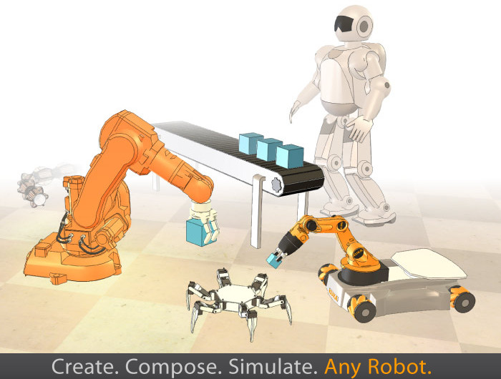

Control

Slide 18
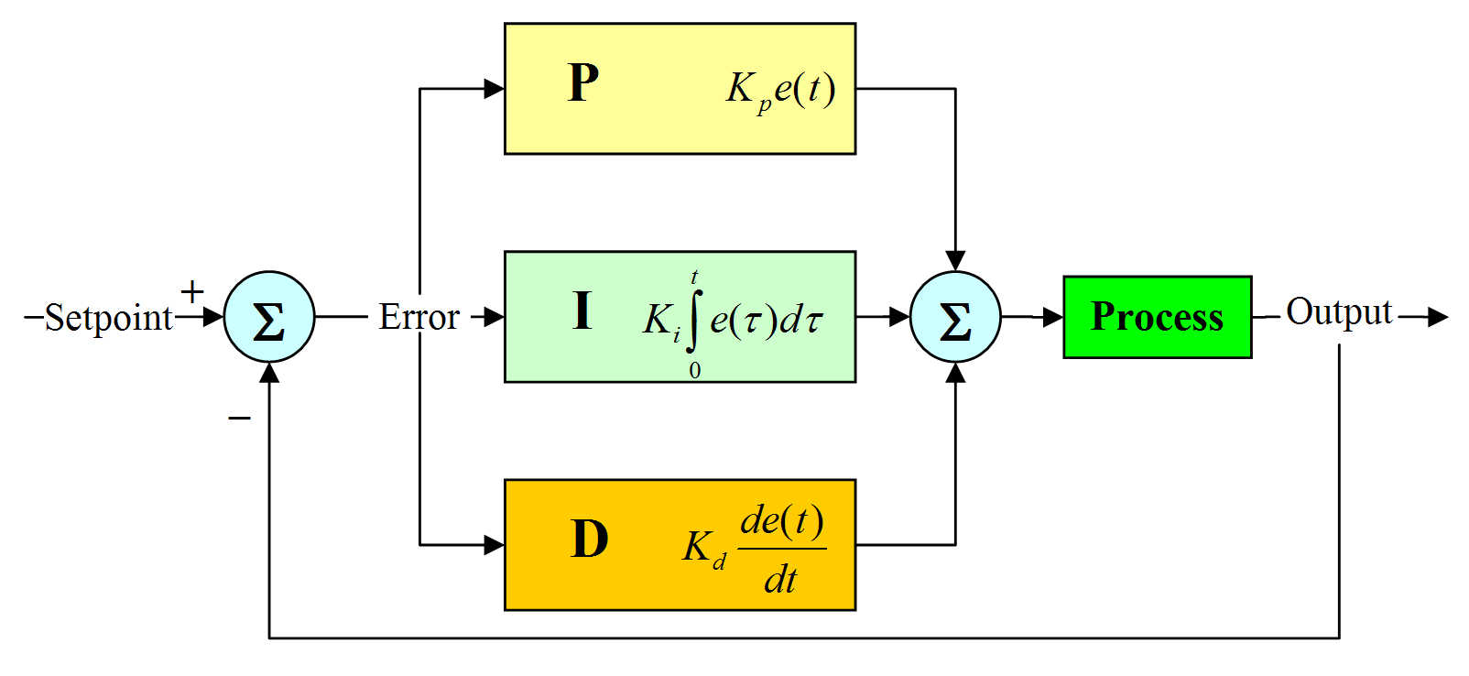
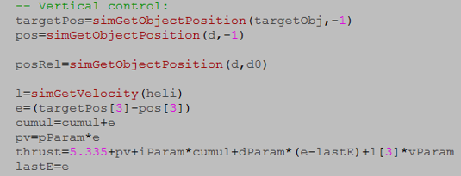
PID for altitude control

Slide 19
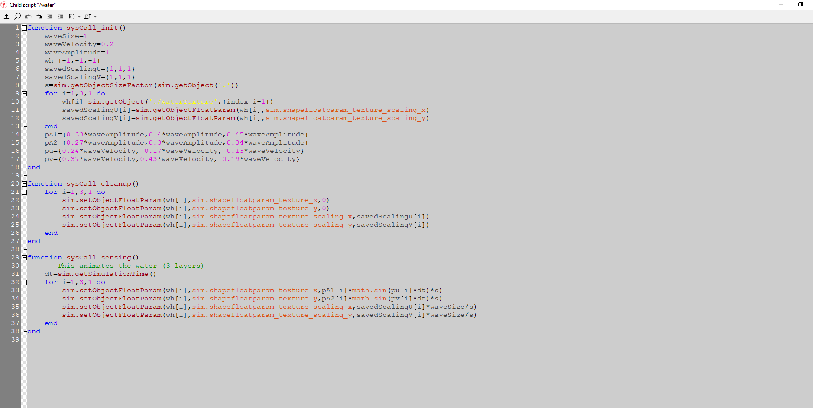
Try to simulate Water space which make my project too difficult if I want to apply!
Notes:
Even though the water friction is a required for the thrust, the water friction due to other components are negligible. Also the water around is uniform and stationary, i.e no disturbing forces just fluidic force.

Slide 20
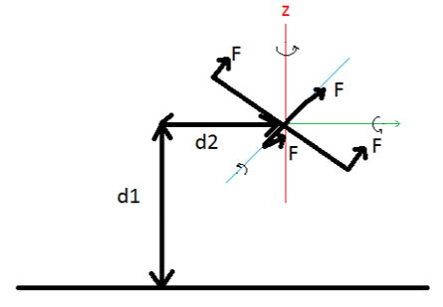
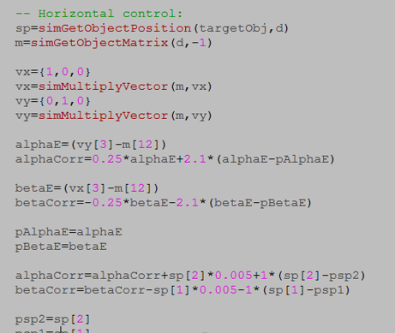
PID for horizontal velocity control

Slide 21
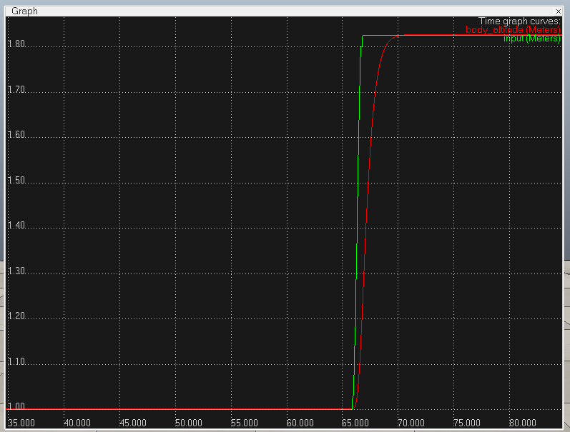
Responses
Altitude

Slide 22
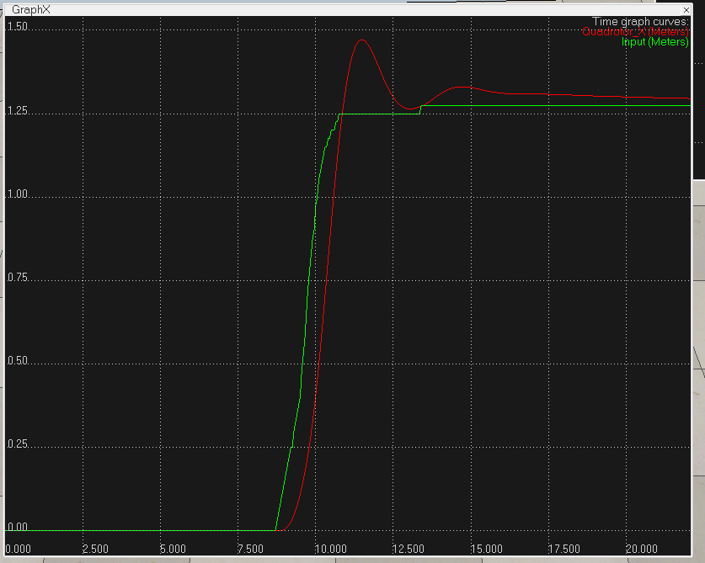
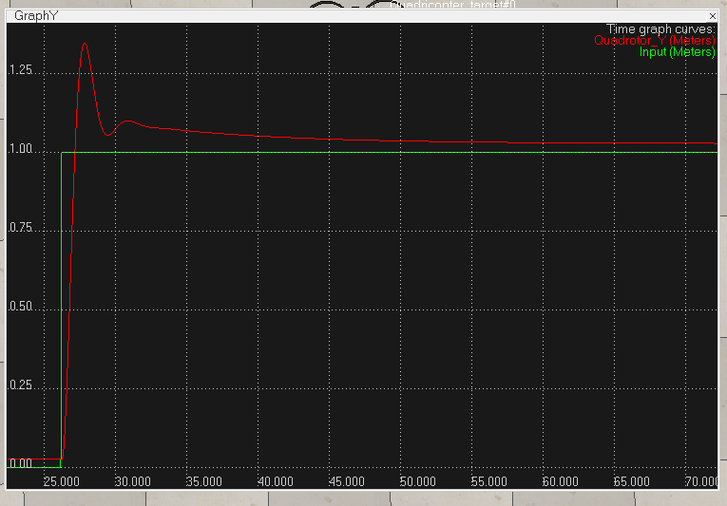
X
Y

Slide 23
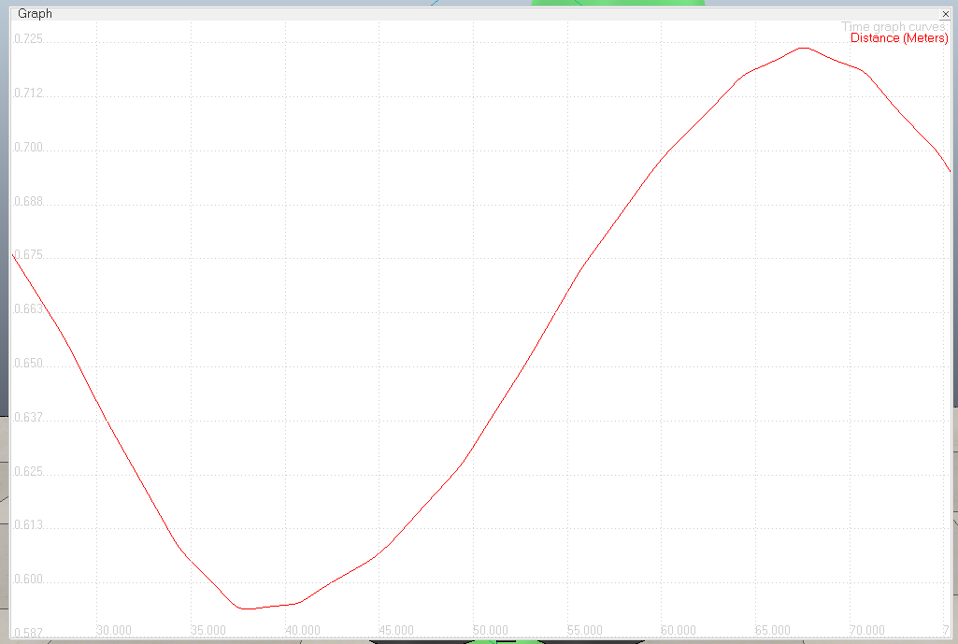
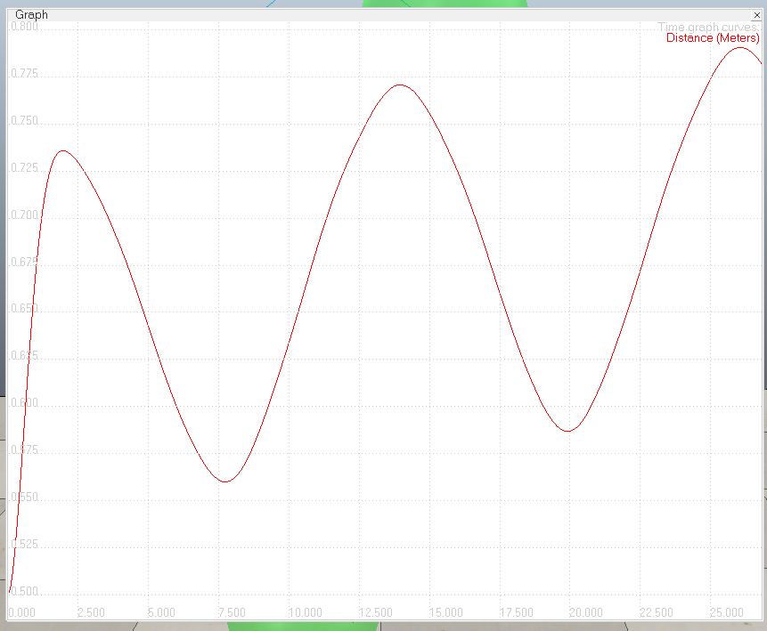
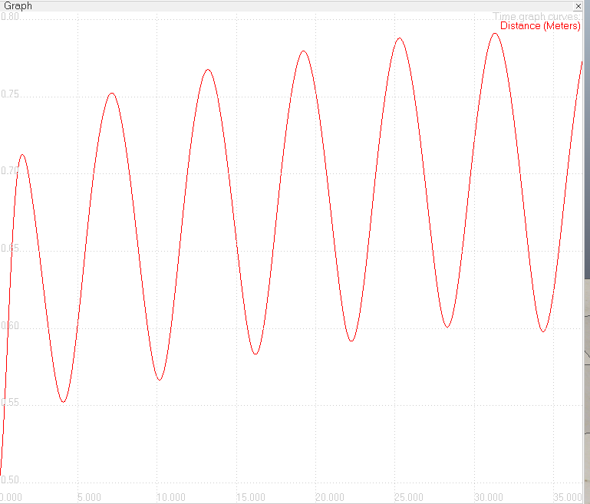
Path following results
High Period
Low Period
Medium Period

Slide 24
Conclusion
I created a dynamic model of a two-seahorse system and used a PID controller to control it so that it followed a closed-path with a variable period.
This project enabled me to quickly learn how to generate D-H parameters and comprehend the dynamic behavior of a two-seahorse system.
It also taught me how to use the lua scripting language and how to utilize the v-rep professional robot simulator.
I had previously used discrete pıd controllers to control position, but in this project ı utilized a pıd controller to manage velocity.
I also obtain path planning and tracking experience. Overall, this project taught me a lot about robotic systems and helped me grasp the topics presented in class better.

Slide 25
Thanks ☺
All files related to this project can be found in:
Https://github.Com/rahashabani/ee587-project

